Slide 1


Surface Finishing with Magneto-Rheology
based Machining Process
By
Project Members
Abijith Gopal R - 211419114003 Arun Kumar K S - 211419114039
Balaji S - 211419114050
Bharath B - 211419114053
Batch No: 04
Under the Supervision
Of
Mr. I.JOHN SOLOMON M.E. , Assistant Professor , Department of Mechanical Engineering,
Panimalar Engineering College.

Slide 2

Abstract
The project represents surface finishing operation by using MR fluid. The surface finish operation carried out on Aluminium (6061) material by using three different compositions of MR fluid as well as at three different speeds. To achieve different speeds, drilling machine is used and initial and final surface roughness values of the work piece at each speed is observed and calibrated by surface roughness tester (Ra value). Different samples are created with three different composition of silicon carbide with iron carbide and de-ionized water.

Slide 3
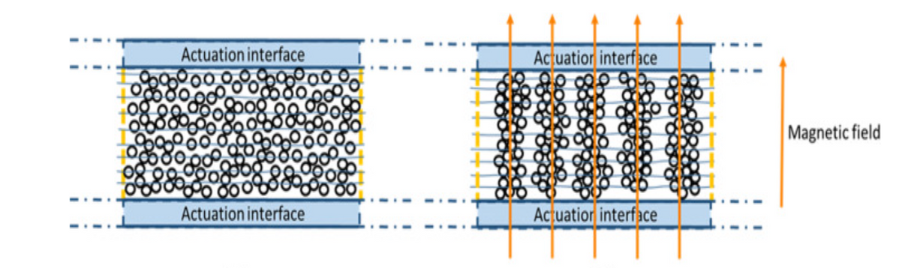
Magneto-rheological fluid (MRF)
Magneto-rheological fluid (MRF) is a type of smart material in which its properties will be changes when the magnetic field imposed on the fluid. In its initial stage i.e., during the absence of magnetic field, MR Fluid acts as a purely in liquid state and during the presence of magnetic field, the fluid increases its viscosity until to the state of viscoelastic (Property that exhibits both viscous and elastic characteristics) solid.

Slide 4
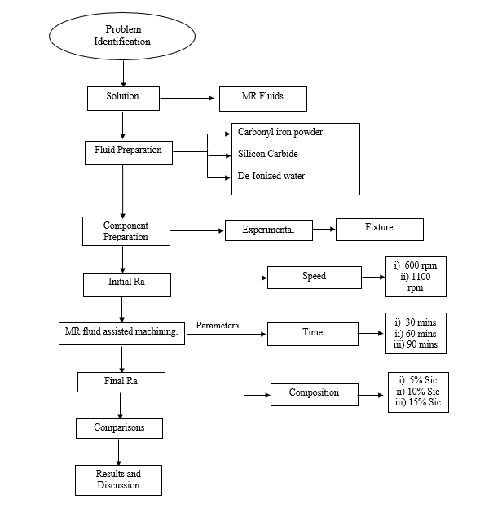
Process Flowchart

Slide 5
MR FLUID MATERIALS
Carbonyl iron powder:
Carbonyl iron powder is formed from several other iron particles.
The particle sizes vary anywhere from 20-200µm.
Carbonyl iron powder composition
Elements | Composition
Assay | 99.5
Lead (Pb) | 0.002
Insoluble matter in HCl | 0.05
Arsenic (As) | 0.0005
Copper (Cu) | 0.005
Manganese (Mn) | 0.05
Sulphide (S) | 0.02
Nickel (Ni) | 0.05

Slide 6
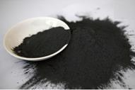
MR FLUID MATERIALS
Silicon Carbide:
Silicon Carbide (SiC) is a compound of silicon and carbon.
It is extremely rare on the earth in mineral form, and it has semiconductor properties.

Slide 7
MR FLUID MATERIALS
De-Ionized Water:
In this project, De-Ionized water at a pH level of about 5-8 is used.
De-Ionised water is specially purified water which eliminates most of the minerals and salt ions
Difference Between Distilled and De ionized Water :
Distillation and deionization are similar in that both processes remove ionic impurities,
but distilled water and deionized water (DI) are not the same and are not interchangeable
for many lab purposes

Slide 8
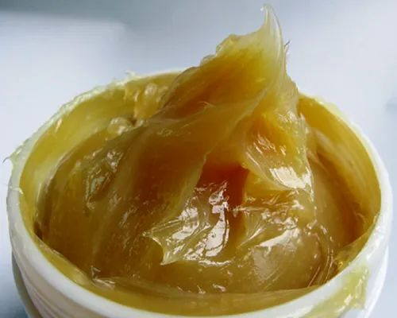
MR FLUID MATERIALS
Lithium Grease:
Due to the weight and density of Carbonyl iron powder and silicon carbide,
they sediment at the bottom of the container/beaker.
To reduce the sedimentation, Lithium Grease is added as stabilizers.

Slide 9
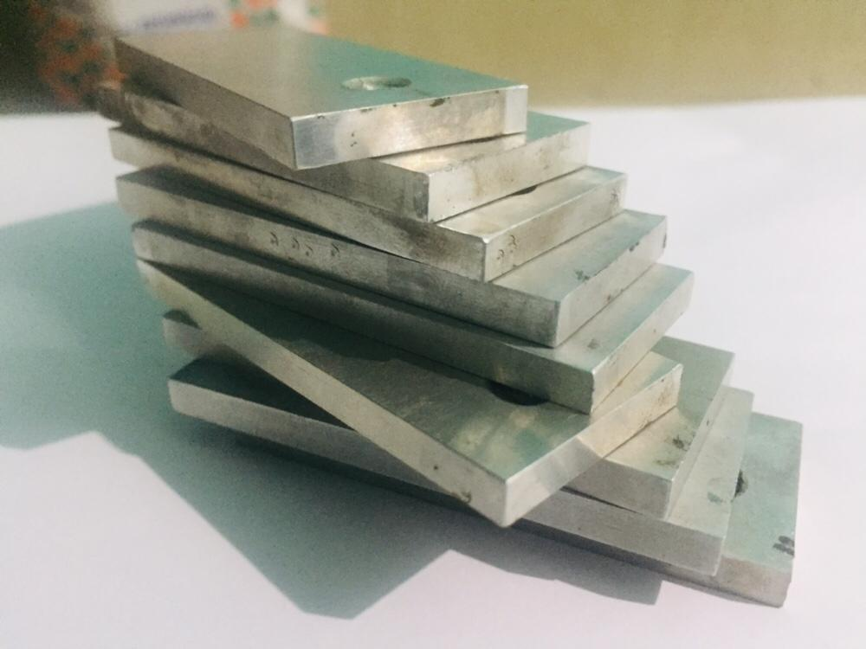
WORK PIECE MATERIAL
Aluminium 6061
Al6061 is a precipitation-hardened aluminium alloy, containing magnesium
and silicon as its major alloying elements.
Many studies and research are still going on to find out the best compatible
and cost-effective finishing process for especially Al6061 material.

Slide 10
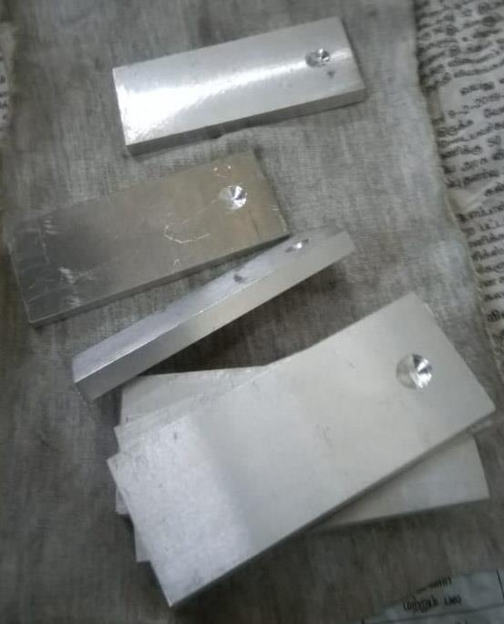
PRE-FINISH OF AL 6061 PLATE
Aluminium 6061
An Al 6061 plate of thickness 5mm was taken and it is converted as per required
dimensions for the project.
The plate was taken into cutting action for the dimension of 60×25×5 mm.
The work pieces are slightly grooved at both the surface of one top end to firmly fit
in between the teeth of the tool.

Slide 11
PREPARATION OF MR FLUID
The carrier fluid used in the project is lithium Grease. Carbonyl iron powder of
size 20µm has been used.
To get a better material removal, Silicon Carbide of size 30 µm is used as abrasive
particles.
Finally, these materials are introduced into De Ionized water at required Compositions.

Slide 12
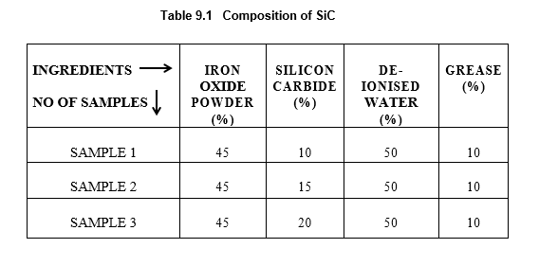
Preparation of Samples
Our project experimental method was carried out by using three different samples by varying the amount of silicon carbide.

Slide 13
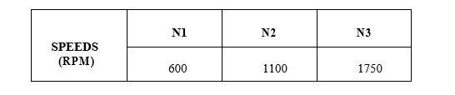
Preparation of Samples
Our project experimental method was carried out by using three different samples by varying the amount of silicon carbide.

Slide 14
Preparation of Samples
Samples :

Slide 15
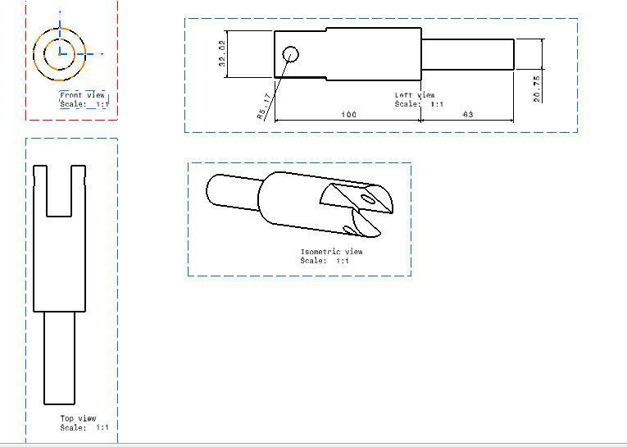
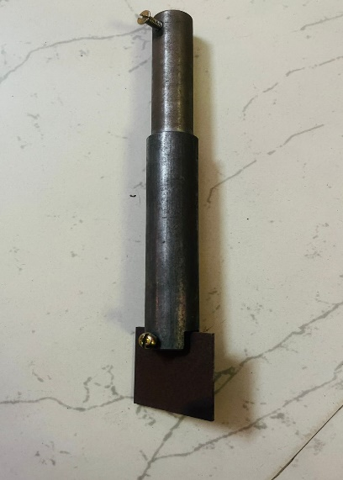
DESIGN OF WORK PIECE HOLDER

Slide 16
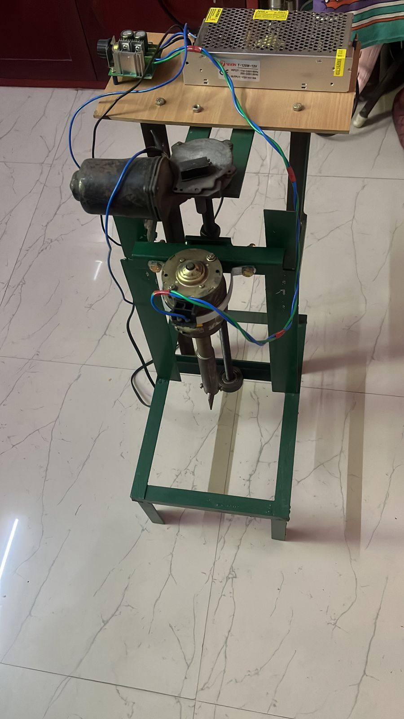
EXPERIMENTAL SETUP

Slide 17
RESULTS AND DISCUSSION
Work piece which had initial surface roughness of about 0.758µm is made to run at 600rpm in a 5% composition and for every 30mins the roughness of the work piece is tested.
It is clear the surface roughness gets reduced and shows a positive result.
The obtained results were, after 30mins the result was 0.651 µm and after 60mins the result was 0.528 µm and after 90mins the result was 0.486 µm.
It is clear upon drawing a graph between time and surface roughness, the surface roughness value drops gradually till 90mins and beyond which it starts increasing.

Slide 18
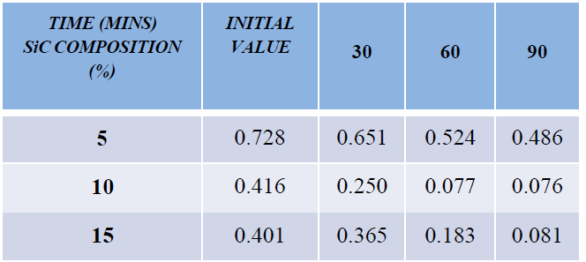
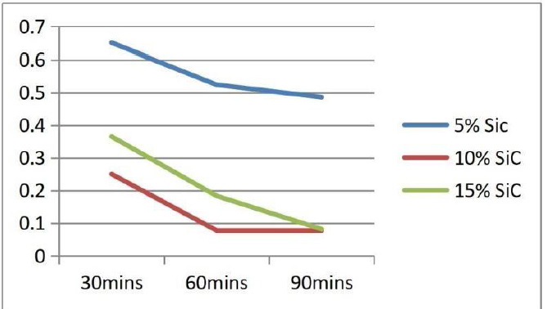
TABULATION
Surface Roughness (Ra) Values at 600 rpm

Slide 19
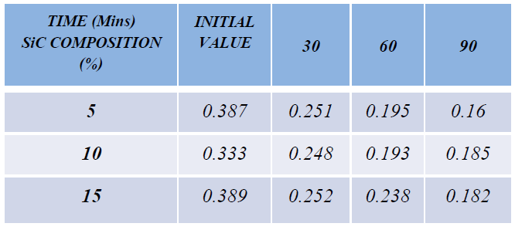
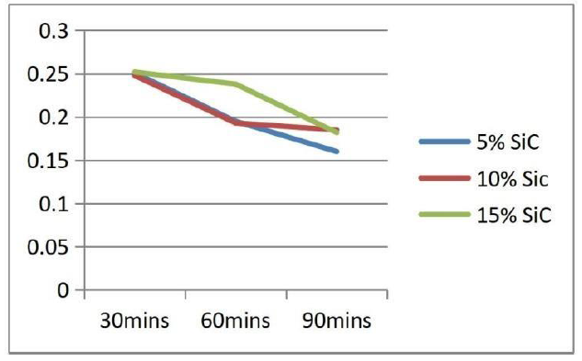
TABULATION
Surface Roughness (Ra) Values at 1100 rpm

Slide 20
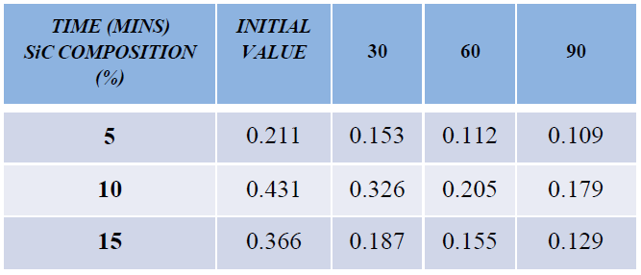
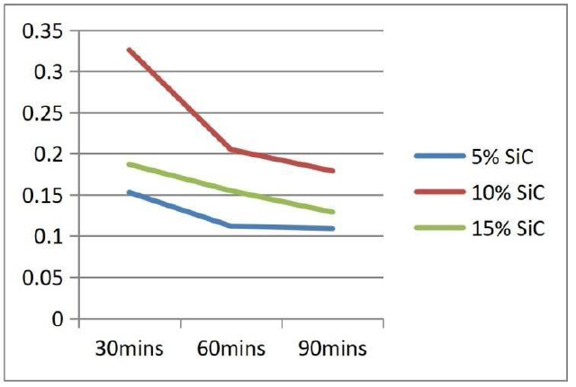
TABULATION
Surface Roughness (Ra) Values at 1750 rpm

Slide 21
Finished work pieces
Work Piece Before Machining
Work Piece After Machining

Slide 22
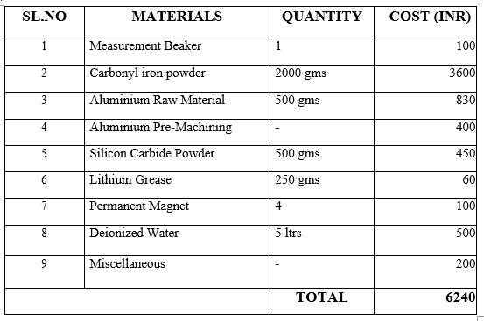
COST ESTIMATION

Slide 23
CONCLUSION
Increasing the magnetic field increases viscos elasticity of the fluid up to to the certain limit and thereafter shear stress involves in the material removal process.
The results and tabulation show that the variation in the surface finish according to the addition of Silicon Carbide.
The variation in rotational speed and consecutive increase of time of rotations for the respective speeds gives a decrement in the roughness value gradually. This gradual decrement is maintained for the particular limit of time and hence the project was taken to the extreme time limit.

